Slide 1
Doing Business with the
Defense Logistics Agency (DLA)

Slide 2
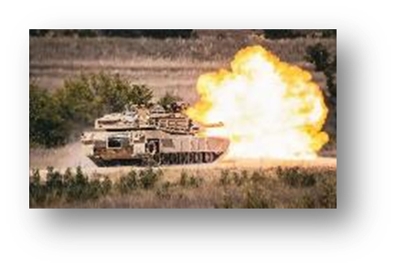


Agenda:
DLA: Who We Are and What We Do
Getting Started
Find Current DLA and Federal Opportunities
Seek Assistance
Conclusion

Slide 3

The Defense Logistics Agency:
Who We Are and What We Do

Slide 4
DLA Transforms: A Call to Action
WARFIGHTER ALWAYS

Slide 5
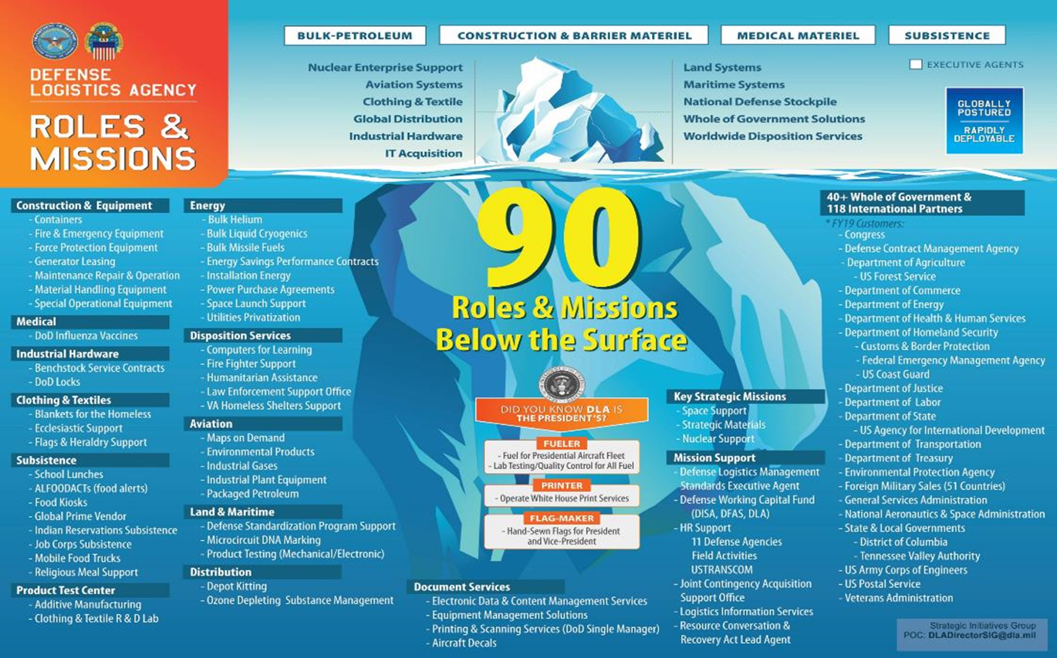
DLA’s Roles & Mission

Slide 6
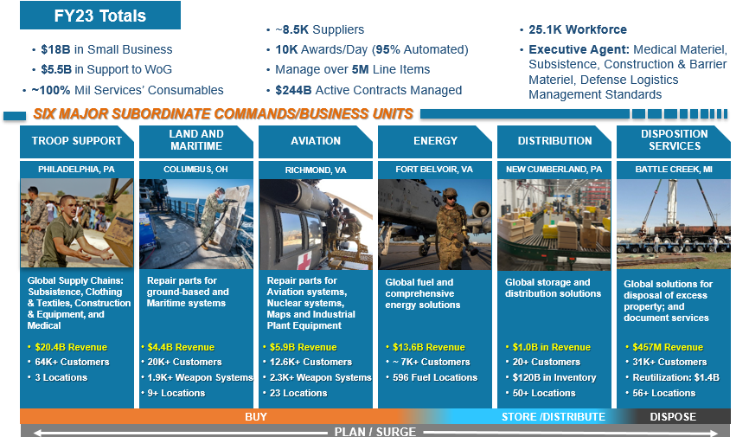
DLA End-to-End Global
Supply Chain Management

Slide 7

Getting Started

Slide 8
Before You Can Sell To DLA
DUNS to New Unique Entity Identifier – Occurred April 4, 2022
Entities doing business with the federal government will use a Unique Entity Identifier (SAM) created in SAM.gov.
If your entity is registered in SAM.gov today, you already have your Unique Entity ID (SAM) and it is viewable in SAM.gov.

Slide 9
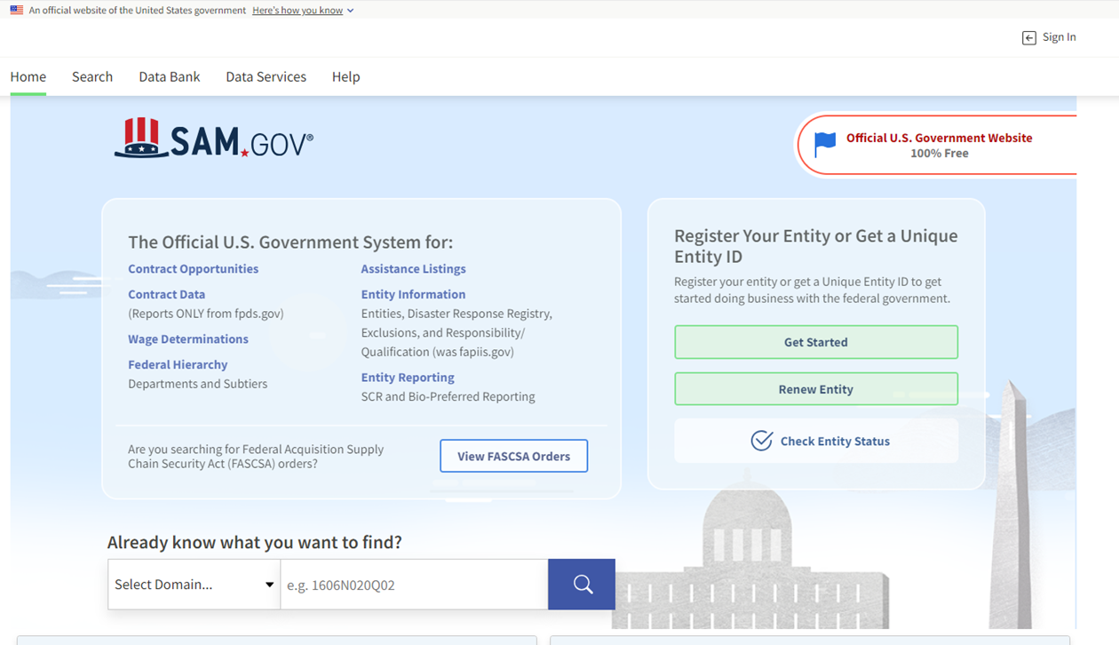
Before You Can Sell To DLA
Register in SAM to get a Commercial and Government Entity (CAGE) Code: www.sam.gov

Slide 10
SBA Small Business Profile
Capabilities Narrative:
  Appears via NAICS Codes, Keywords, Location, etc.
Performance History (Items for Consideration):
  This provides a location to promote a company.
  The company’s best private, commercial or government completed contracts.
  List the highest contract and the lowest contract - shows your range of capabilities.
  Keep it current

Slide 11
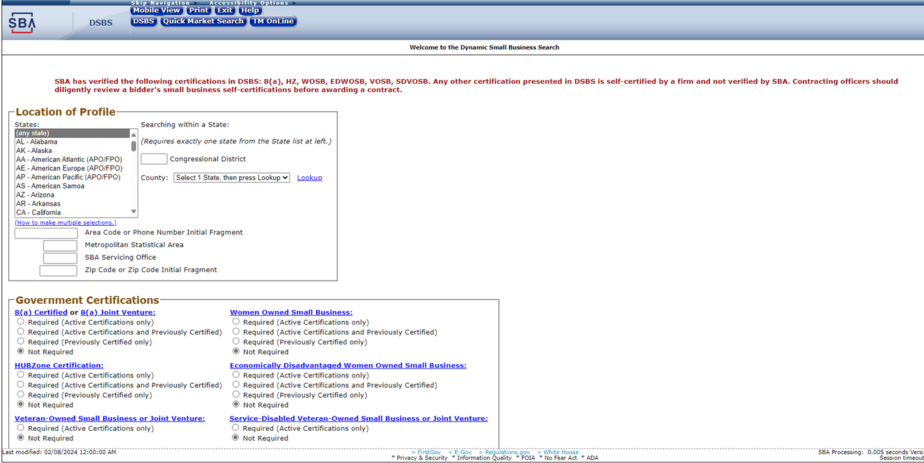
SBA Dynamic Small Business Search
https://web.sba.gov/pro-net/search/dsp_dsbs.cfm

Slide 12
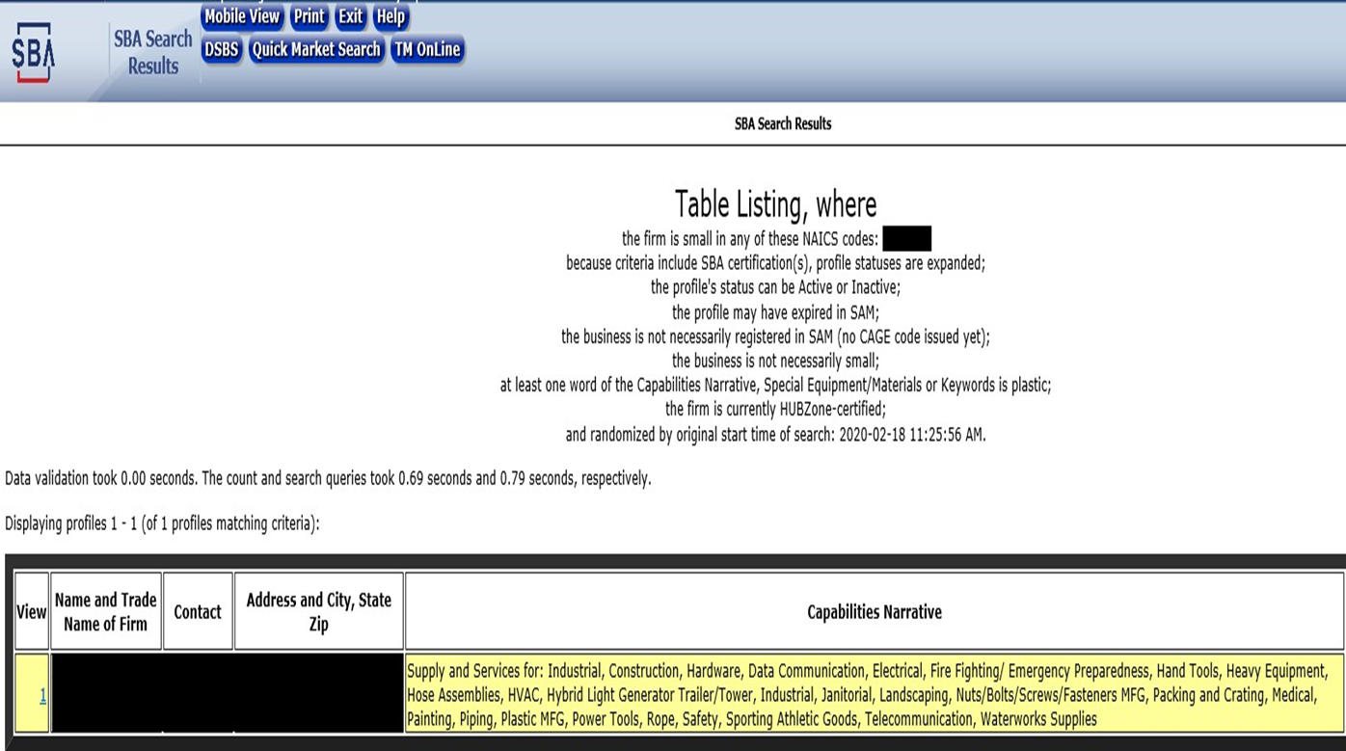
SBA Dynamic Small Business Search

Slide 13
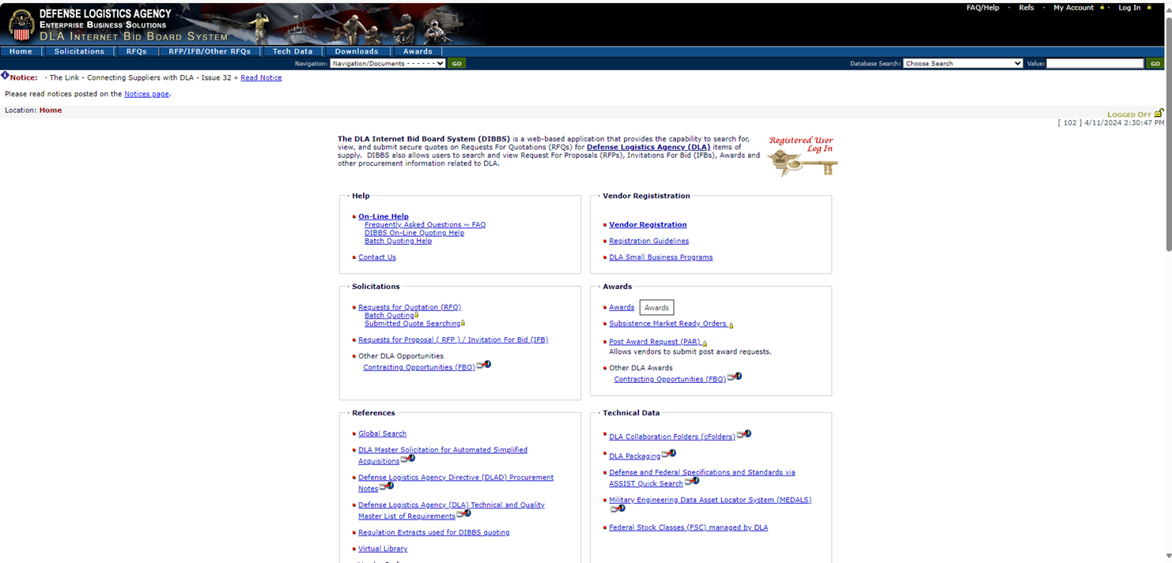
Before You Can Sell To DLA
Register in DLA Internet Bid Board Systems (DIBBS)
https://www.dibbs.bsm.dla.mil/

Slide 14
What is on DIBBS?
DLA Internet Bid Board System (DIBBS):
  View Solicitations and Submit Quotes
  View RFPs
  View Long Term Contracts Opportunities
  View Provisions, Clauses, and Packaging Specifications
  View Award History
  Access Drawings and Technical Data (*cFolders)
  Access Forecast (estimate) Information (Supplier Requirements Visibility Application or SRVA)
  Access the Supplier Performance Risk System (*SPRS
  *Additional Account Needs Established

Slide 15
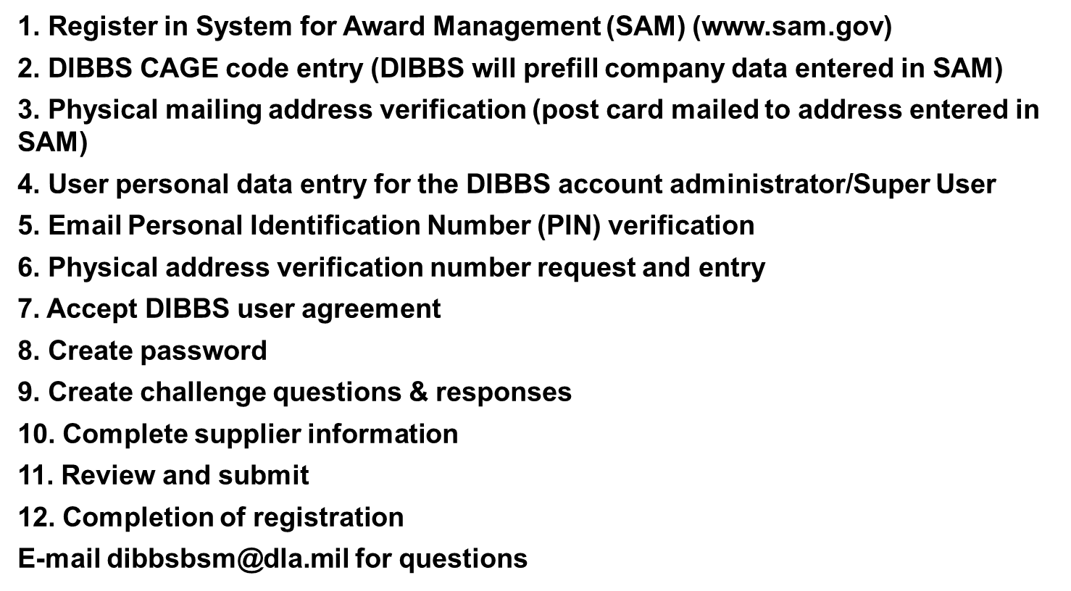
DIBBS Registration Steps

Slide 16
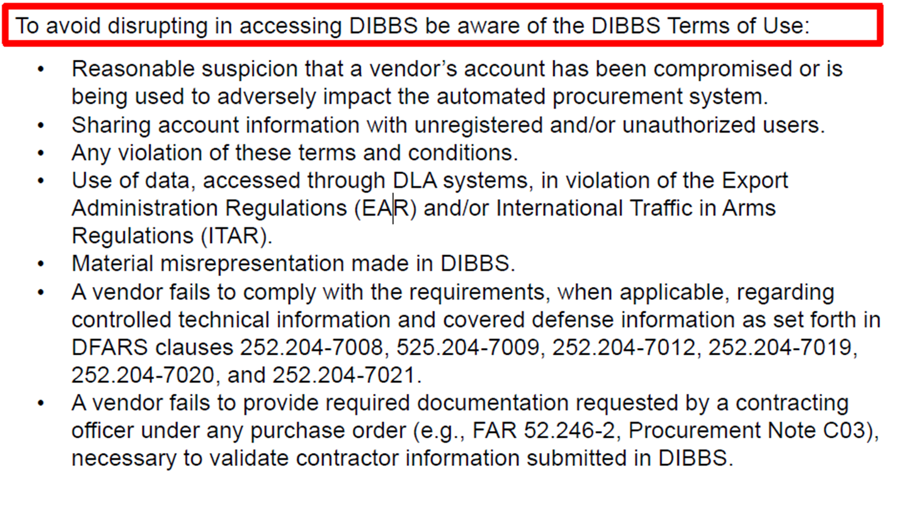
DIBBS Terms of Use

Slide 17
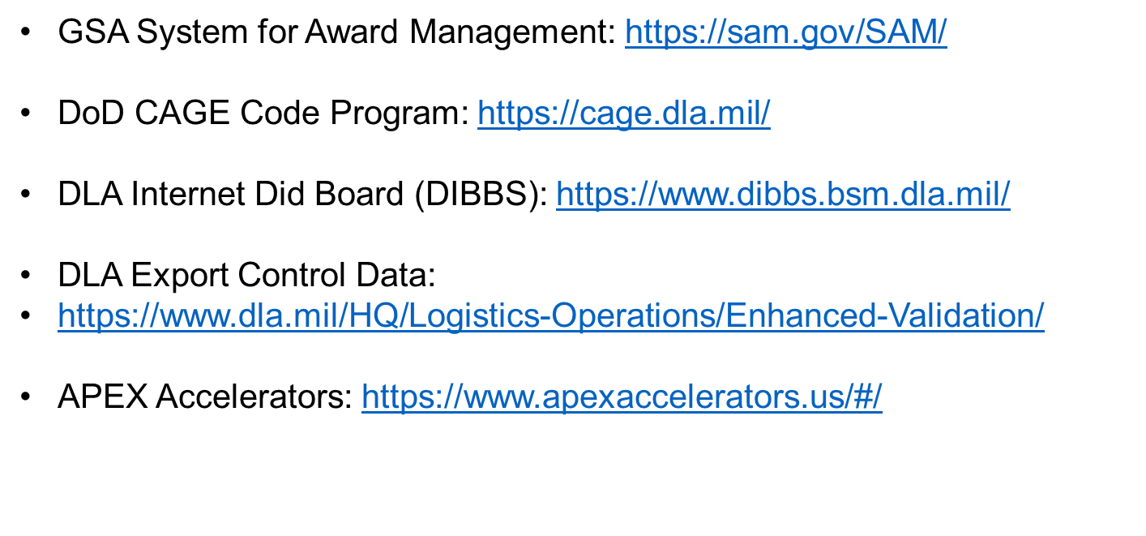
Useful Links

Slide 18

Find Current DLA and Federal Opportunities

Slide 19
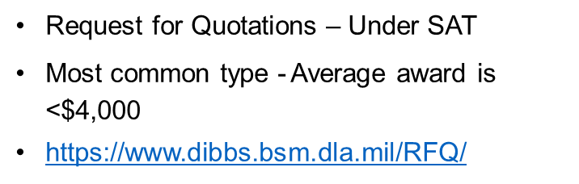
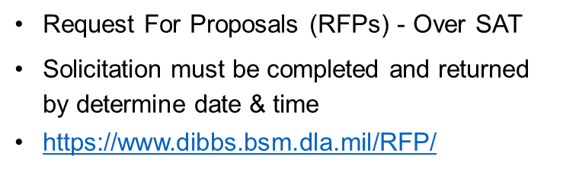
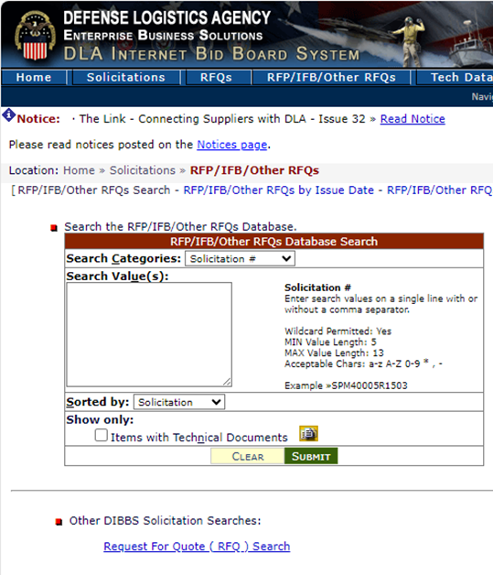
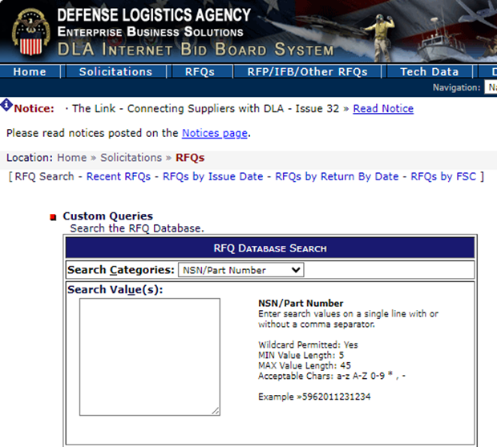
Common Solicitation Types at DLA Supply Centers

Slide 20
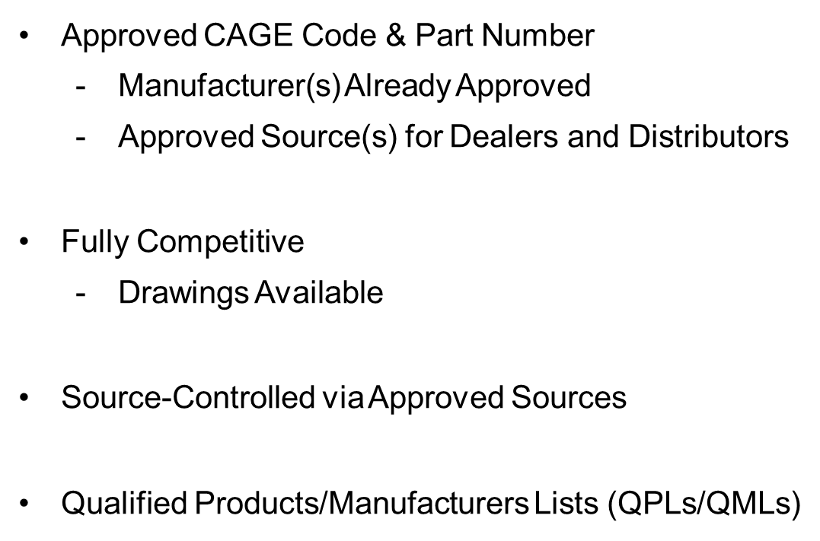

How DLA MSCs Buy

Slide 21
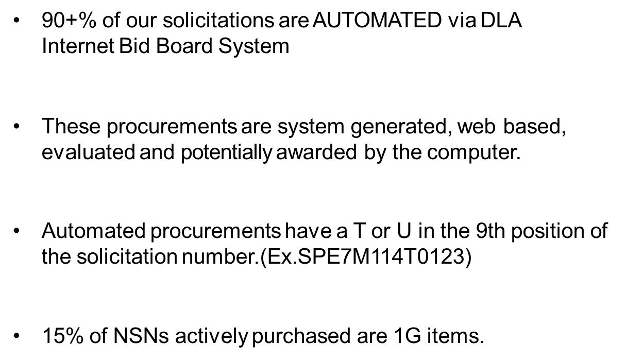
What is on DIBBS?

Slide 22
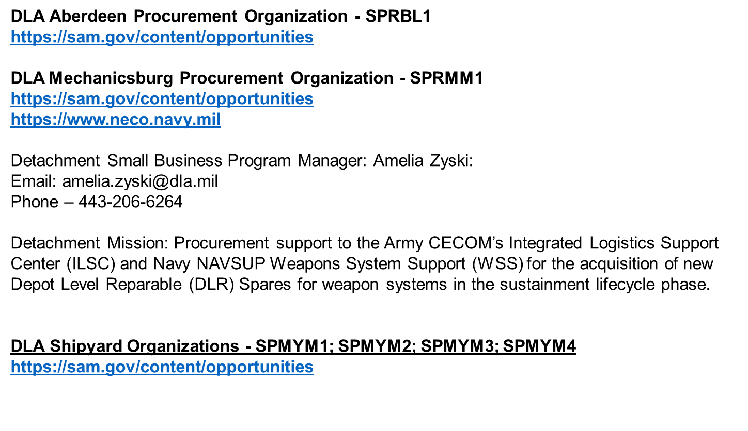
DLA Detachments and Shipyards

Slide 23
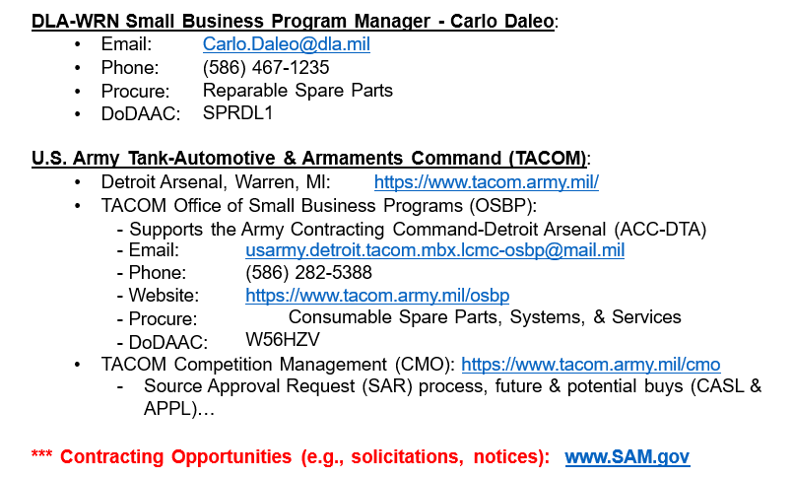
DLA Land-Warren (DLA-WRN)

Slide 24
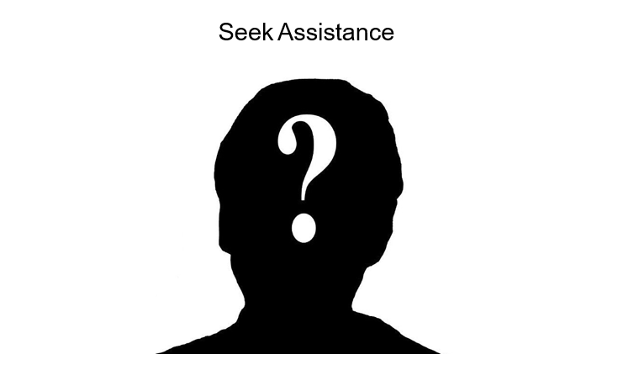

Slide 25
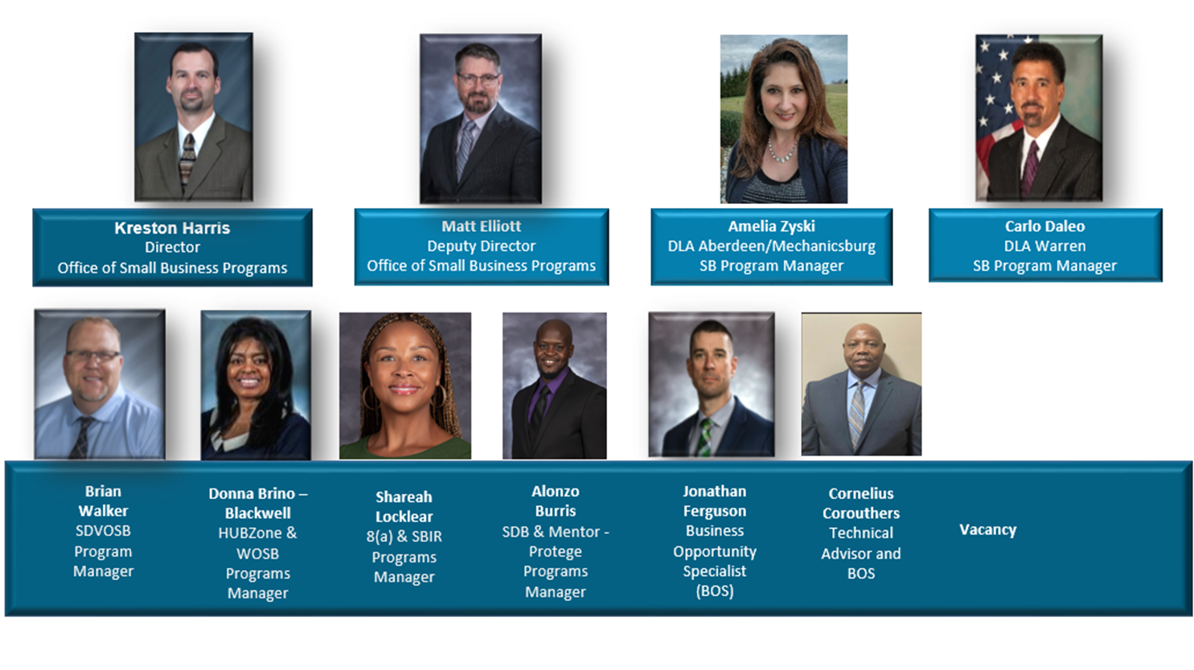
Office of Small Business Programs
DLA Land and Maritime

Slide 26
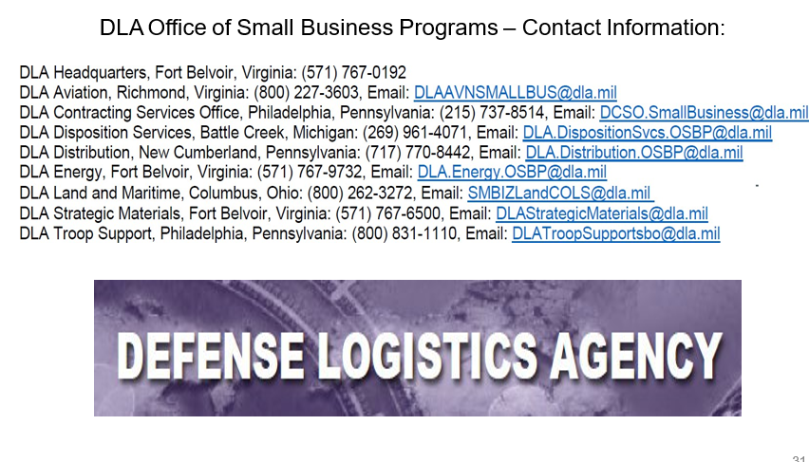
DLA Office of Small Business Programs

Slide 27
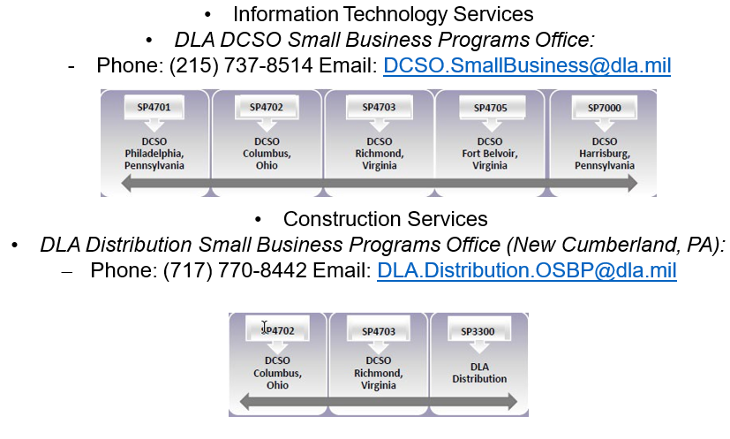
Small Business Professional Services

Slide 28
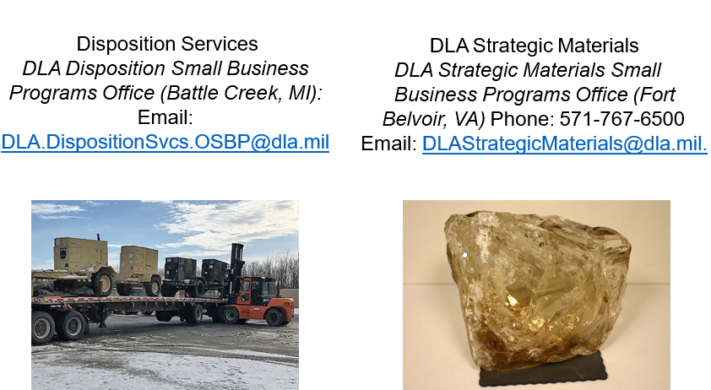

Slide 29
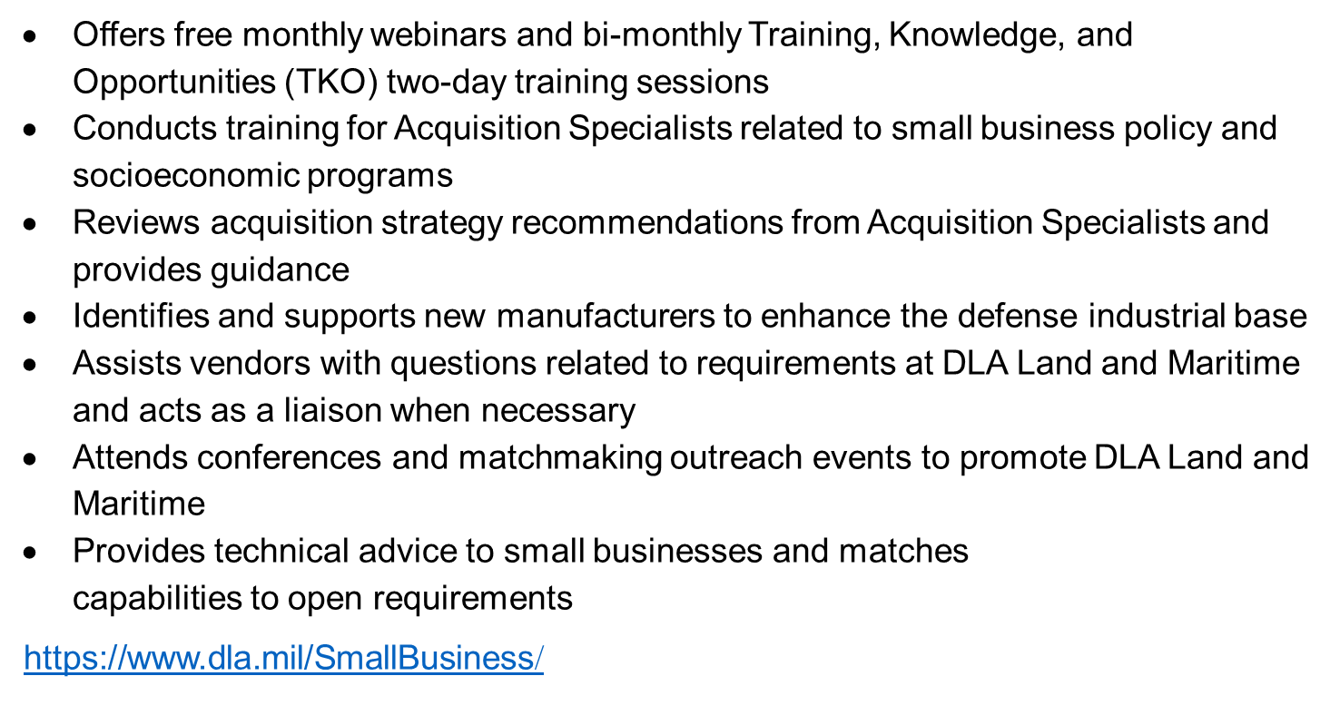
DLA Land and Maritime Office of Small Business Programs

Slide 30
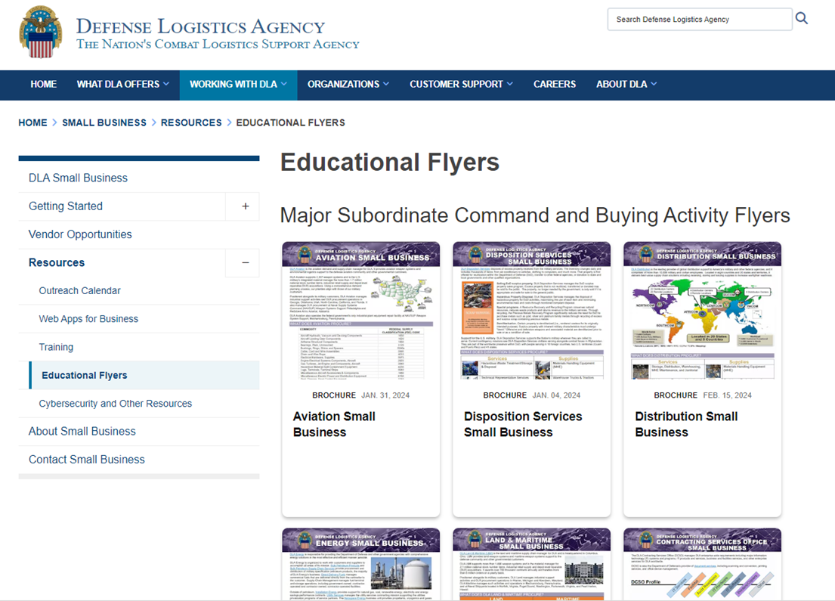
Educational Flyers

Slide 31
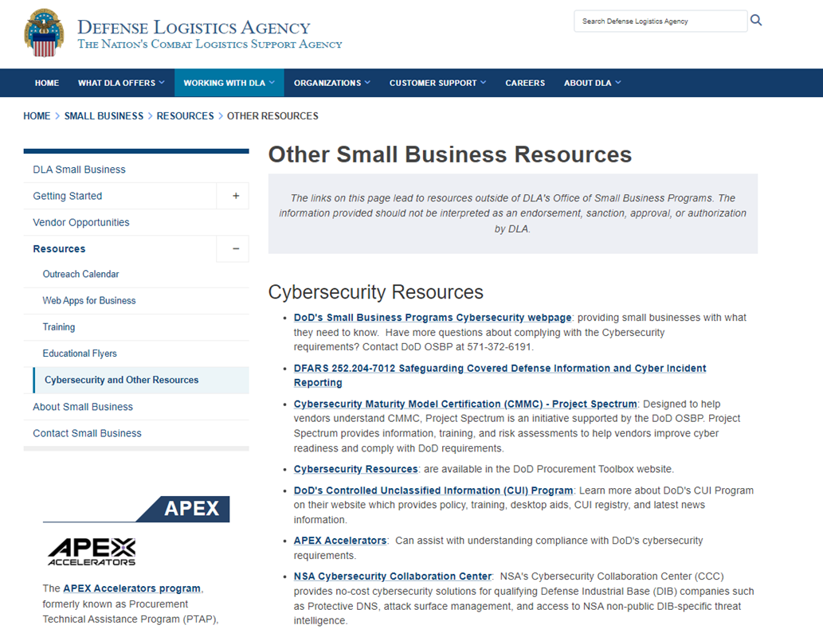
Other Small Business Resources

Slide 32
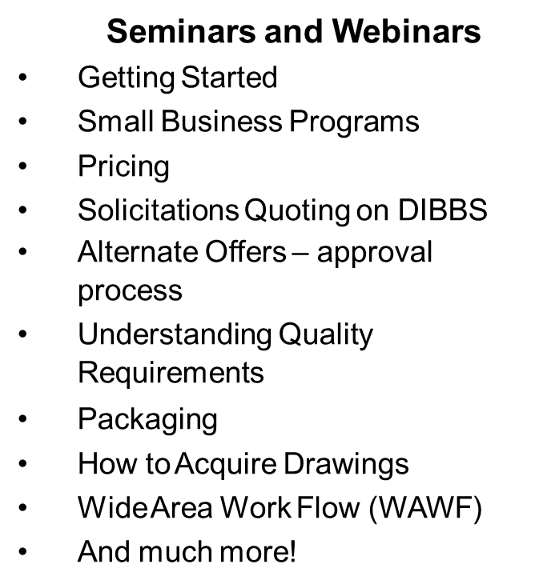


DLA Training Opportunities

Slide 33
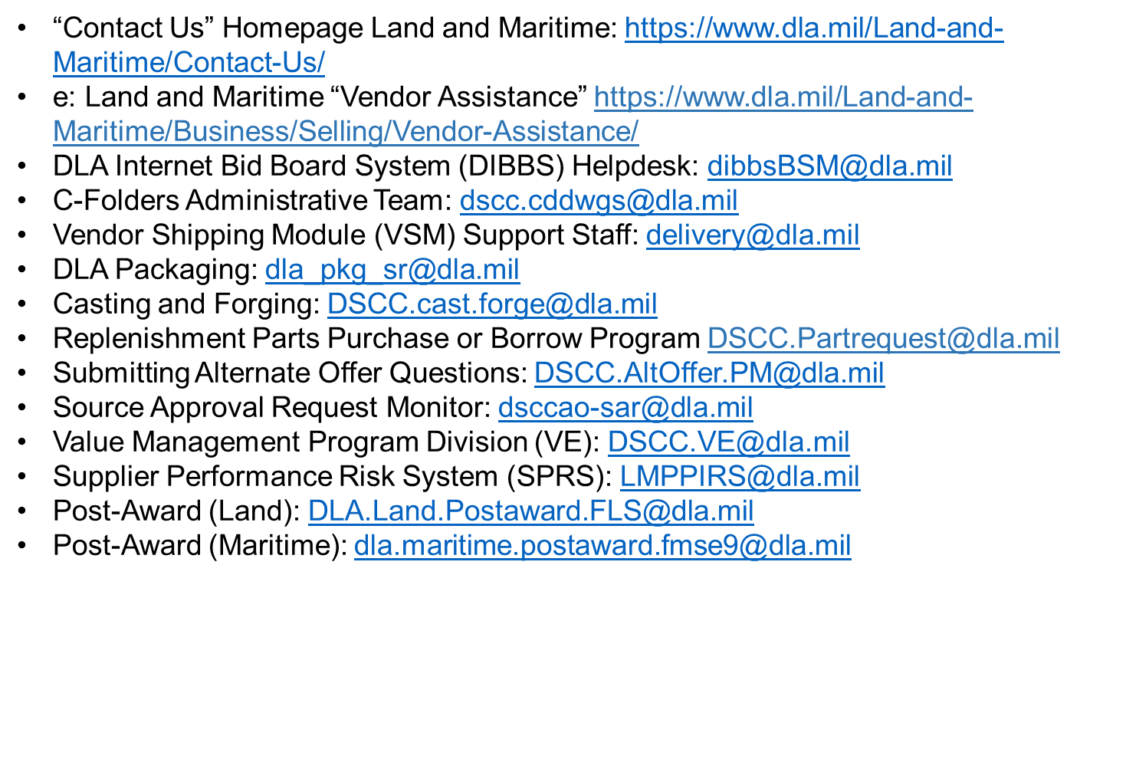
Land and Maritime Points of Contact

Slide 34
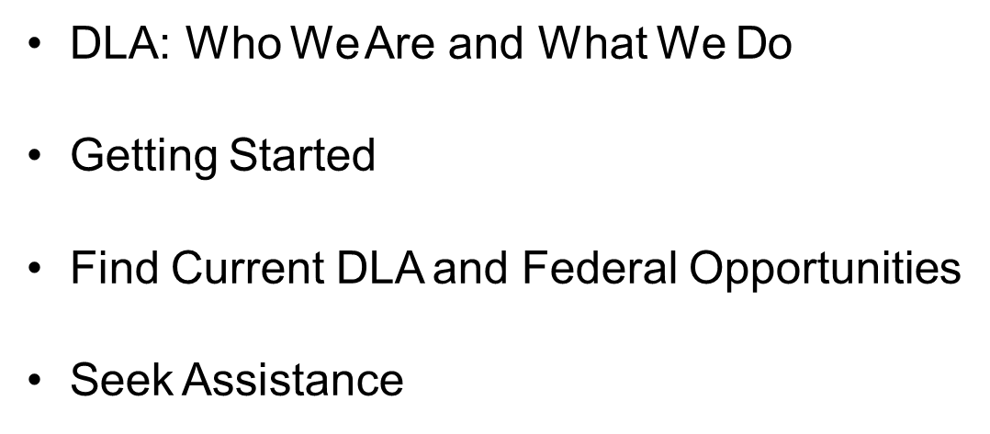

Review

Slide 35

Conclusion

